Slide 1

Andrew McCarren
L235 ext 8456
Andrew.mccarren@dcu.ie

Slide 2

  Form of regression that allows the prediction of discrete variables by a mix of continuous and discrete predictors.
  Addresses the same questions that discriminant function analysis and multiple regression do but with no distributional assumptions on the predictors (the predictors do not have to be normally distributed, linearly related or have equal variance in each group)

Slide 3
  Logistic regression is often used because the relationship between the DV (a discrete variable) and a predictor is non-linear
    The probability of heart disease changes very little with a ten-point difference among people with low-blood pressure, but a ten point change can mean a drastic change in the probability of heart disease in people with high blood-pressure.

Slide 4

  Can the categories be correctly predicted given a set of predictors?
    Usually once this is established the predictors are manipulated to see if the equation can be simplified.
    Can the solution generalize to predicting new cases?
    Comparison of equation with predictors plus intercept to a model with just the intercept

Slide 5
  What is the relative importance of each predictor?
    How does each variable affect the outcome?
    Does a predictor make the solution better or worse or have no effect?

Slide 6
  Are there interactions among predictors?
    Does adding interactions among predictors (continuous or categorical) improve the model?
    Continuous predictors should be centered before interactions made in order to avoid multi-collinearity.
  Can parameters be accurately predicted?
  How good is the model at classifying cases for which the outcome is known ?

Slide 7
  What is the prediction equation in the presence of covariates?
  Can prediction models be tested for relative fit to the data?
    So called “goodness of fit” statistics
  What is the strength of association between the outcome variable and a set of predictors?
    Often in model comparison you want non-significant differences so strength of association is reported for even non-significant effects.

Slide 8

  Odds – like probability. Odds are usually written as “4 to 1 odds” which is equivalent to 1 out of five or .2 probability or 20% chance, etc.
    The problem with probabilities is that they are non-linear
    Going from .10 to .20 doubles the probability but going from .80 to .90 barely increases the probability.

Slide 9
Odds ratio – the ratio of the odds over 1 – the odds. The probability of winning over the probability of losing. 4 to 1 odds equates to an odds ratio of .20/.80 = .25.

Slide 10
Logit – this is the natural log of an odds ratio; often called a log odds even though it really is a log odds ratio. The logit scale is linear and functions much like a z-score scale.

Slide 11
LOGITS ARE CONTINOUS, LIKE Z SCORES
p = 0.50, then logit = 0
p = 0.70, then logit = 0.84
p = 0.30, then logit = -0.84

Slide 12

Y = A BINARY RESPONSE (DV)
  1 POSITIVE RESPONSE (Success) →P
  0 NEGATIVE RESPONSE (failure) →Q = (1-P)
MEAN(Y) = P, observed proportion of successes
VAR(Y) = PQ, maximized when P = .50, variance depends on mean (P)
XJ = ANY TYPE OF PREDICTOR → Continuous, Dichotomous, Polytomous

Slide 13
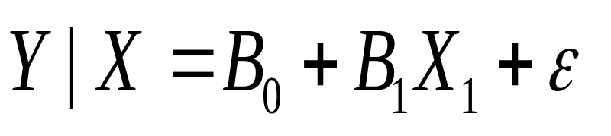
and it is assumed that errors are normally distributed, with mean=0 and constant variance (i.e., homogeneity of variance)

Slide 14
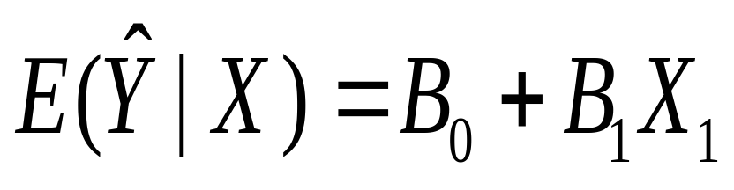
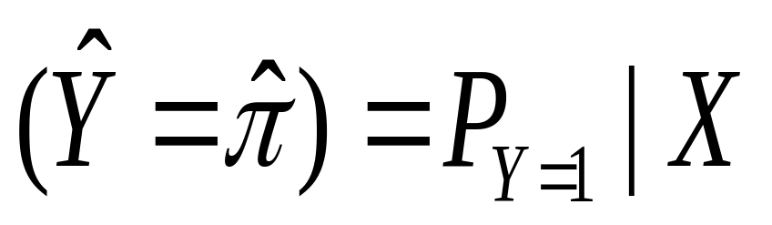
an expected value is a mean, so
The predicted value equals the proportion of observations for which Y|X = 1; P is the probability of Y = 1(A SUCCESS) given X, and Q = 1- P (A FAILURE) given X.

Slide 15
Every respondent is given a probability of success and failure which leads to every person having drastically different variances (because they depend on the mean in discrete cases) causing a violation of the homoskedasticity assumption.

Slide 16
Long story short – you can’t use regular old regression when you have discrete outcomes because you don’t meet homoscedasticity rules.

Slide 17

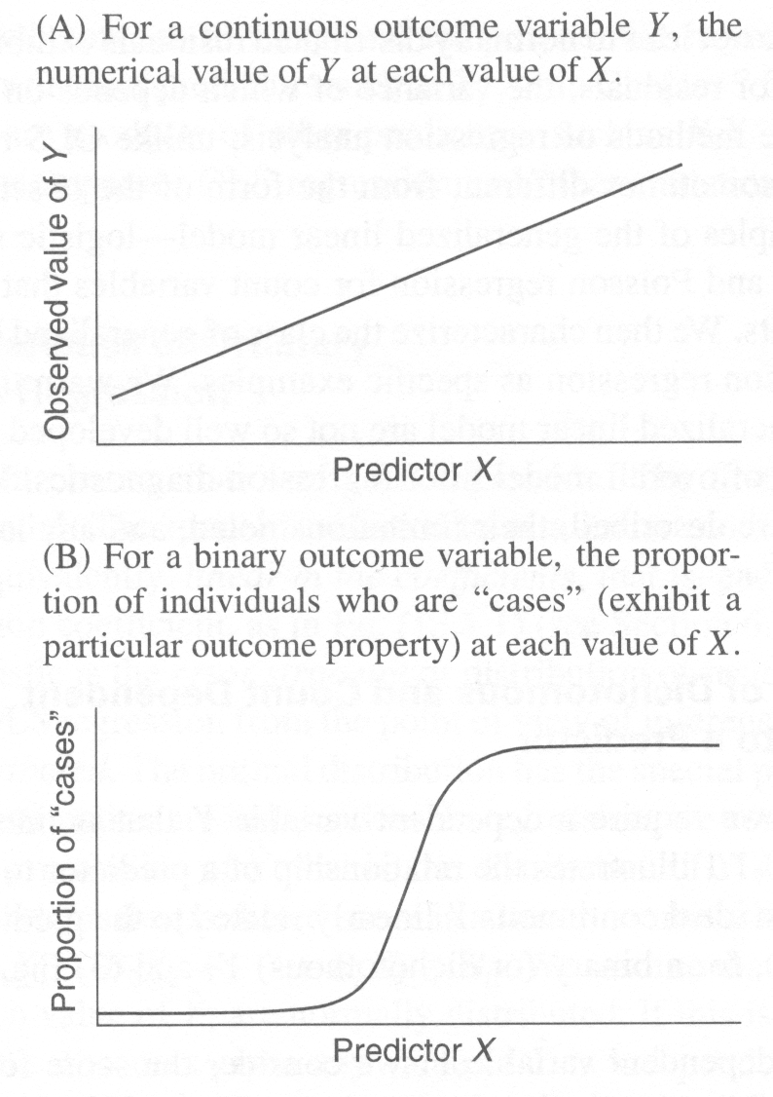

Slide 18

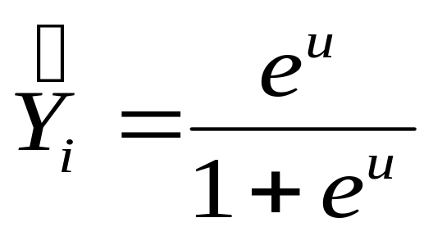
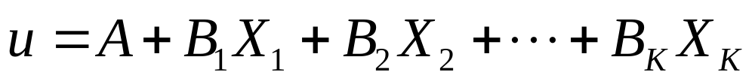
Where Y-hat is the estimated probability that the ith case is in a category and u is the regular linear regression equation:

Slide 19
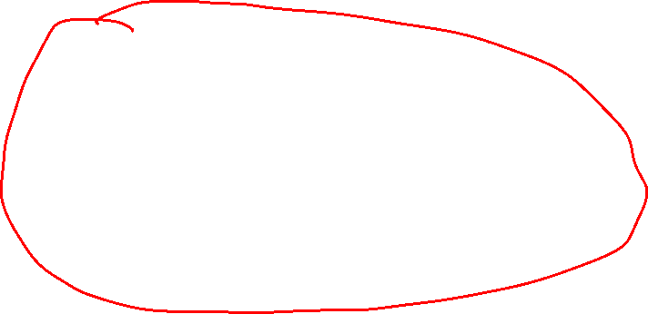
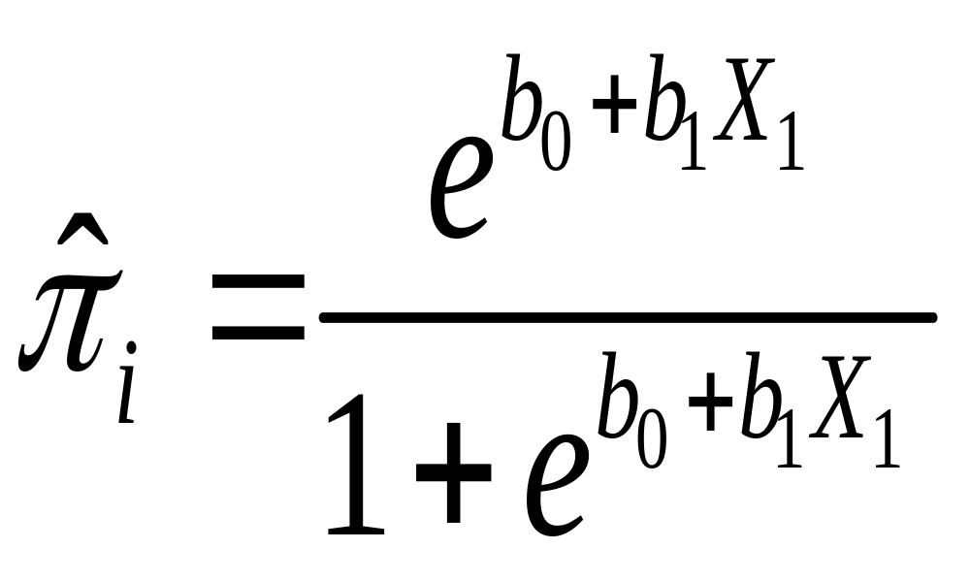

Slide 20
Change in probability is not constant (linear) with constant changes in X
This means that the probability of a success (Y = 1) given the predictor variable (X) is a non-linear function, specifically a logistic function

Slide 21
It is not obvious how the regression coefficients for X are related to changes in the dependent variable (Y) when the model is written this way
Change in Y(in probability units)|X depends on value of X. Look at S-shaped function

Slide 22

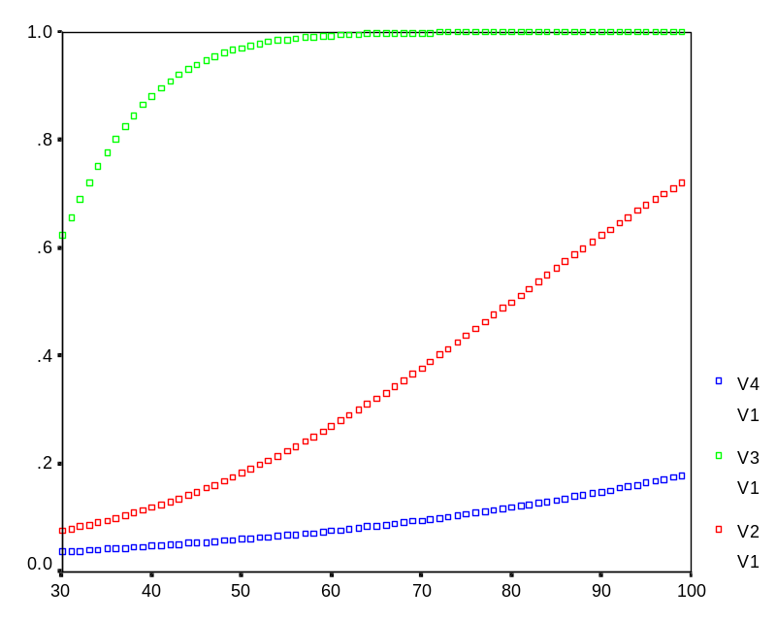
Constant regression constant different slopes
  v2: b0 = -4.00
  b1 = 0.05 (middle)
  v3: b0 = -4.00
  b1 = 0.15 (top)
  v4: b0 = -4.00
  b1 = 0.025 (bottom)

Slide 23
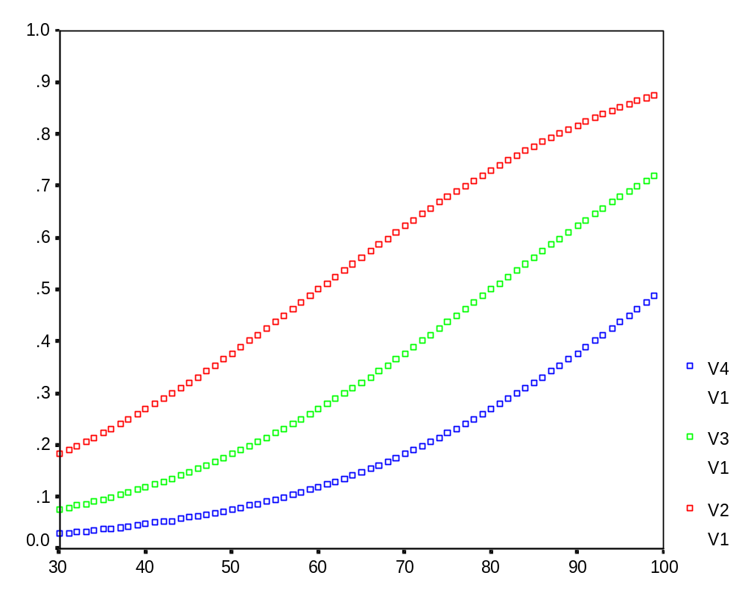
Constant slopes with different regression constants
  v2: b0 = -3.00
  b1 = 0.05 (top)
  v3: b0 = -4.00
  b1 = 0.05 (middle)
  v4: b0 = -5.00
  b1 = 0.05 (bottom)

Slide 24

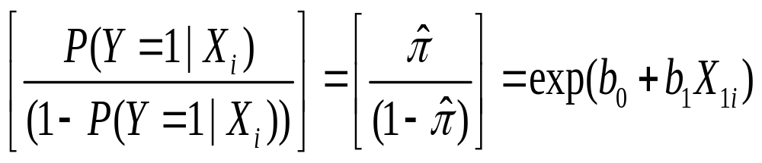
By algebraic manipulation, the logistic regression equation can be written in terms of an odds ratio for success:

Slide 25
Odds ratios range from 0 to positive infinity
Odds ratio: P/Q is an odds ratio; less than 1 = less than .50 probability, greater than 1 means greater than .50 probability

Slide 26
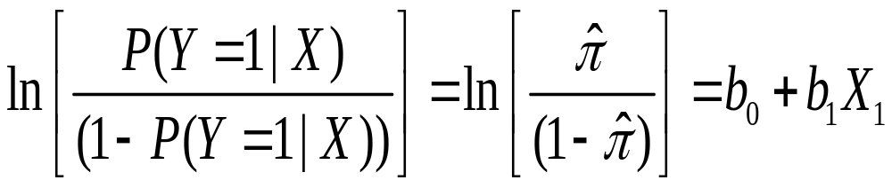
Finally, taking the natural log of both sides, we can write the equation in terms of logits (log-odds):
For a single predictor

Slide 27
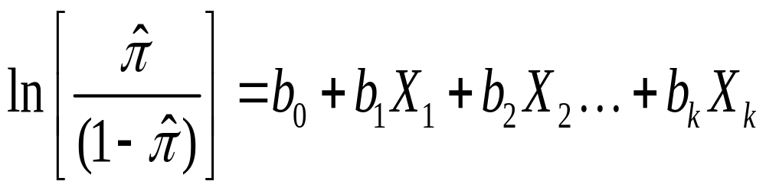
For multiple predictors

Slide 28
The values in the regression equation b₀ and b₁ take on slightly different meanings.
  b₀ ← The regression constant (moves curve left and right)
  b₁ <- The regression slope (steepness of curve)
        The threshold, where probability of success = .50

Slide 29
Log-odds are a linear function of the predictors
The regression coefficients go back to their old interpretation (kind of)
  The expected value of the logit (log-odds) when X = 0
  Called a ‘logit difference’; The amount the logit (log-odds) changes, with a one unit change in X; the amount the logit changes in going from X to X + 1

Slide 30

EXP(logit) or = odds ratio
Probability = odd ratio / (1 + odd ratio)

Slide 31

The only “real” limitation on logistic regression is that the outcome must be discrete.

Slide 32
  Ratio of cases to variables – using discrete variables requires that there are enough responses in every given category
    If there are too many cells with no responses parameter estimates and standard errors will likely blow up

Slide 33
Linearity in the logit – the regression equation should have a linear relationship with the logit form of the DV. There is no assumption about the predictors being linearly related to each other.

Slide 34
Absence of multicollinearity
No outliers
Independence of errors – assumes a between subjects design. There are other forms if the design is within subjects.

Slide 35

Check for Multi-Collinearity
R-Squared Adjusted
Other assessments such as:
  AIC
  BIC
True Positive rate vs False Positive rate
  ROC curve
  Area under the curve

Slide 36
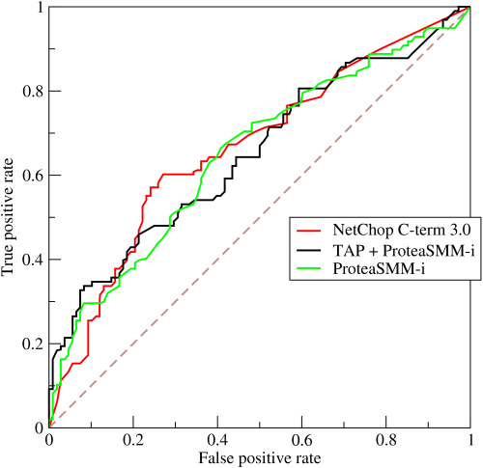
ROC Curve Cont.
  Measure the area under the ROC curve
    Poor fit – area under the ROC curve approximately equal to 0.5
    Good fit – area under the ROC curve approximately equal to 1.0
Logistic Regression

